Slide 1

Rainfall Prediction Model

Slide 2
01
Project Overview

Slide 3

Objective of the project
The primary objective of this project is to develop a machine learning model that accurately predicts whether it will rain tomorrow based on various weather parameters.
This predictive capability can significantly enhance decision-making in fields such as agriculture, event planning, and emergency management.

Slide 4
Dataset source and description
The dataset used for this project is the WeatherAUS.csv obtained from the Australian Bureau of Meteorology.
This dataset contains daily weather observations for various locations across Australia.
It includes key columns such as Date, Location, MinTemp, MaxTemp, Rainfall, Evaporation, Sunshine, and Wind Gust Direction, providing ample data for analysis and model training.

Slide 5
Key dataset characteristics
The WeatherAUS dataset consists of 142,193 rows and 24 columns.
It includes various features that can be categorized into numerical (e.g., MinTemp, MaxTemp, Rainfall, WindSpeed) and categorical (e.g., Location, RainToday, WindGustDir).
The target variable for prediction is RainTomorrow, which is binary (Yes/No).
The dataset's richness allows for comprehensive analysis but also presents challenges such as missing values that need to be addressed.

Slide 6
02
Data Preprocessing

Slide 7
Handling missing values
To manage missing values within the dataset, various strategies will be implemented.
For numerical features like Evaporation and Sunshine, missing values will be imputed using statistical measures such as mean or median.
For critical features with a significant amount of missing data, rows may be dropped or replaced to maintain dataset integrity and prevent bias in model training.

Slide 8
Encoding categorical variables
Categorical variables present in the dataset, such as Location, RainToday, and WindGustDir, require encoding to be effectively used in machine learning models.
Techniques like Label Encoding, which assigns each category a unique integer, or One-Hot Encoding, which creates binary columns for each category, will be employed.
This ensures that the models can interpret categorical data appropriately without introducing ordinal relationships.

Slide 9
Model Training and Evaluation Process
Data Splitting
Split the dataset into training and test sets to assess model performance, often using an 80/20 split for effective evaluation.
Model Training
Train the selected models on the training dataset to learn patterns and make predictions based on the data.
Hyperparameter Tuning
Utilize GridSearchCV or RandomizedSearchCV to optimize hyperparameters for models like Random Forest and XGBoost for better performance.
Cross-Validation
Perform cross-validation to ensure the model’s performance is stable and reliable, reducing overfitting and improving generalization.

Slide 10
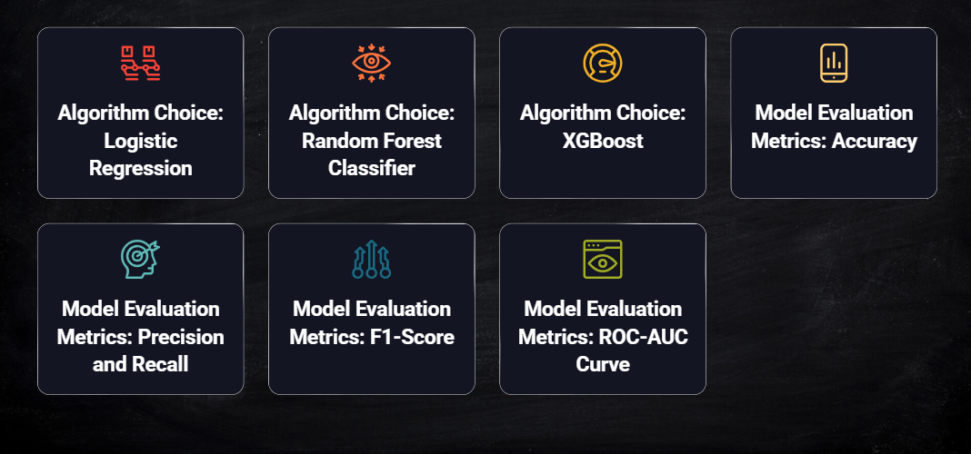
Selecting the Right Model

Slide 11
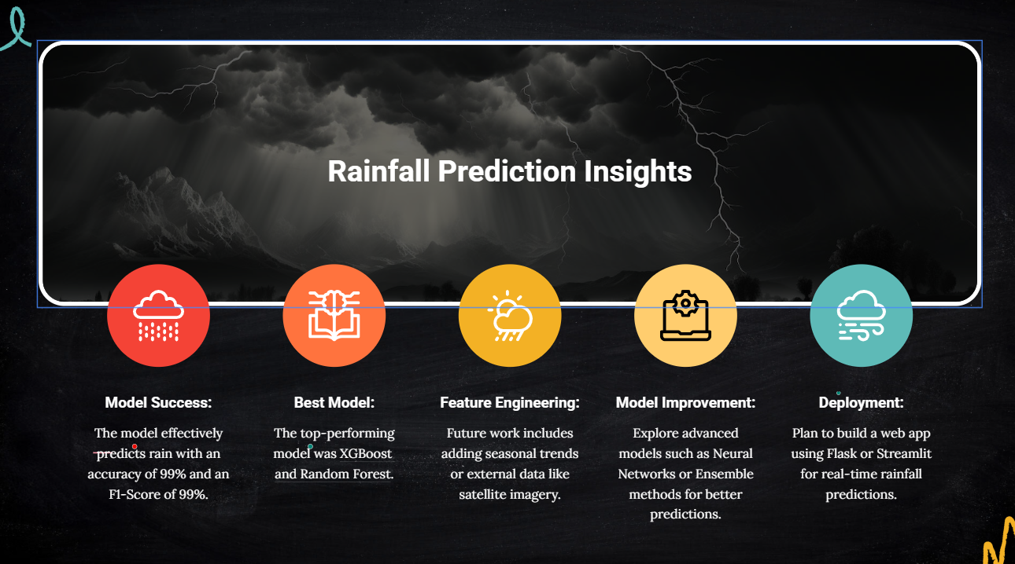

Slide 12
Thank you!
Do you have any questions?

